Slide 1
FY 2017-18 Funding Request Focus
What resource areas do we need to sustain, revise, support to serve learners well?

Slide 3
The Basics of a Superintendent’s Funding Request
Vision, Mission, Goals, Priorities, Actions
Continuation of Phased-In Strategic Initiatives
Maintenance of Effort
Growth
Compensation and Benefits
Expansion of Strategic Priorities

Slide 5
Initiatives in Progress
School Nurses
Learning Technology Support
Elementary Languages Programming
Professional Development and Training

Slide 7
Equity, Access, Parity
Equity of program, instructional quality, staff, assessment = elimination of achievement and performance gaps
Access to rich, defined curriculum, engaged learning, learning technologies and support services = elimination of achievement and performance gaps
Parity in learning spaces (classrooms, libraries, art, music, PE, etc.), learning resources (science lab and CTE equipment, research databases)
Technology, books, etc., program offerings = elimination of achievement and performance gaps

Slide 9
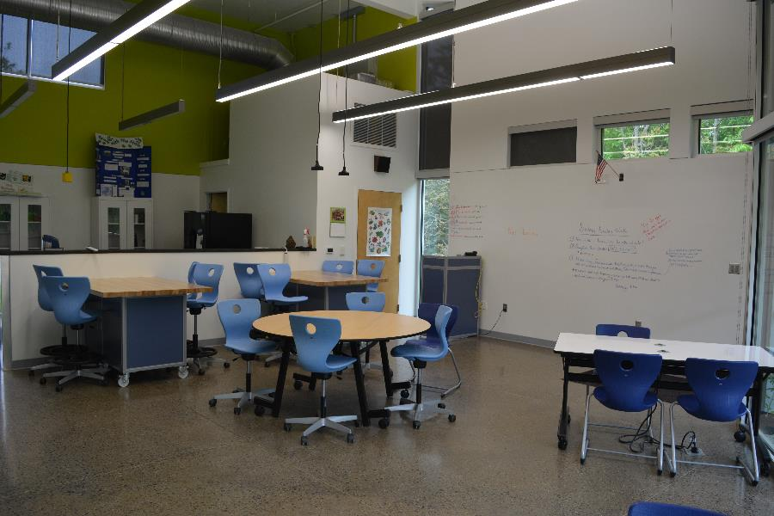
Learning Work Consistent With Lifelong-Learner Competencies
Floor is accessible
Ceiling is
high
Walls are
wide

Slide 11
Data
Poverty
ESL
Special Education
Title I
Learning Performance – all data sets (State of the Division)
Counseling/Mental Health
Discipline
Student Feedback – boredom/engagement/like
ACES Survey CDC report (childhood trauma)

Slide 13
Equity, Access, Parity
Supplemental Services
Volunteerism
CIP
PTO Fundraising
Support Services
Specialty Programs and Transportation
Summer Programming
Tech Infrastructure and Support (home and school)

Slide 15
Engagement & Feedback Process
School Leaders with Concentrated Poverty
All Principals
Advisories – parent, teacher, special education, student, financial, etc.
Special Teacher Focus Group
Community Survey
School Board

Slide 17
What’s Next:
Superintendent’s Funding Request
State of the Division Report to Board
Board Direction to Superintendent
Input and Feedback from Stakeholders to Superintendent
Governor’s Budget (school funding and VRS)
Joint Board Meetings
Funding Request Development Process – Dr. Haas with Cabinet and departmental team support
Superintendent’s Funding Request Presentation to Board

